Slide 1
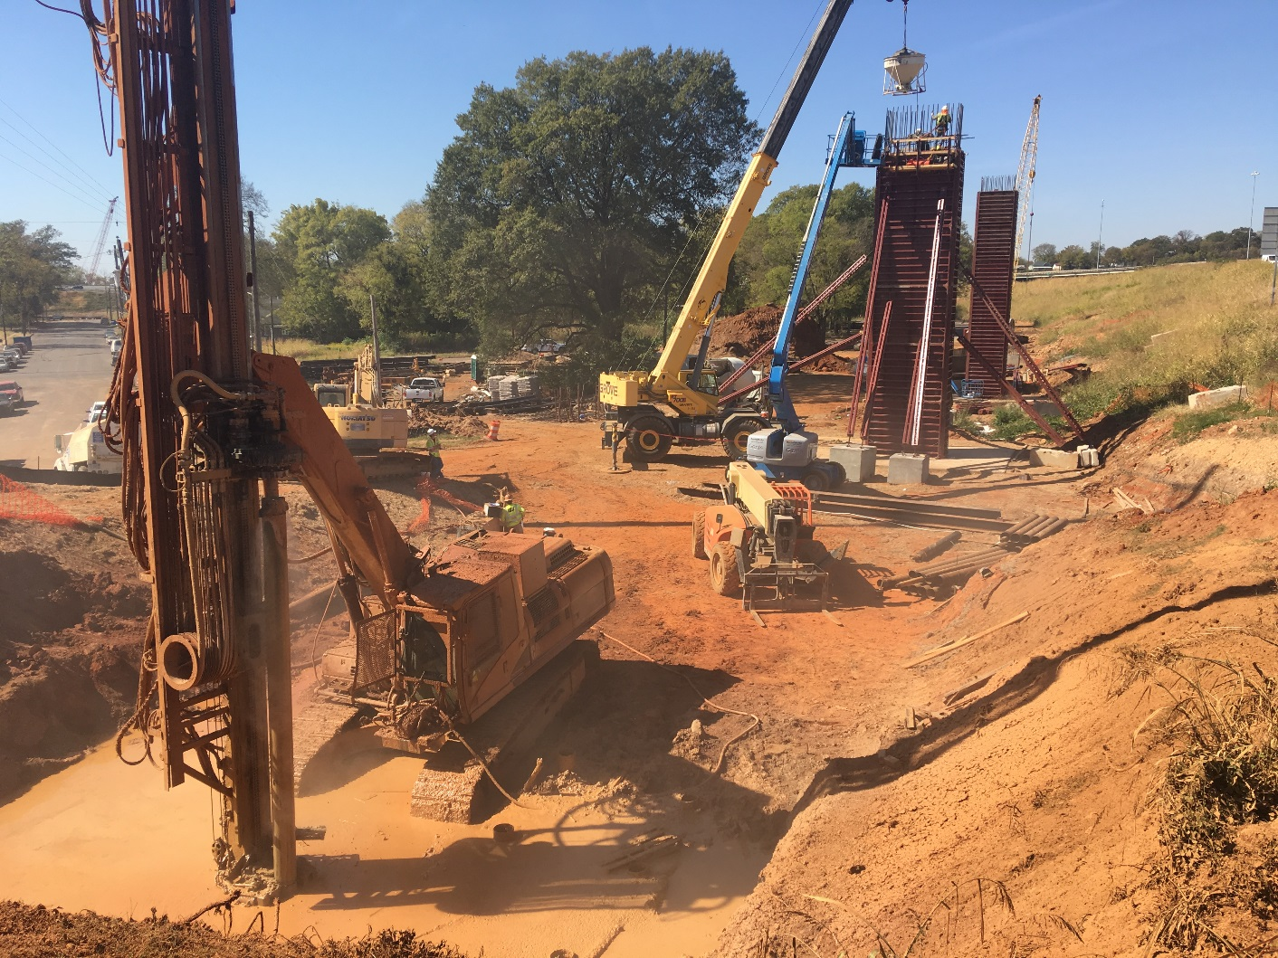


Micropiles for Bridge Foundations in Karst Terrain
I-20/59 & I-65 Interchange Modification Project
Birmingham, AL
Matt Revell, P.E.
Assistant Geotechnical Engineer
ALDOT Bureau of Materials & Tests

Slide 2

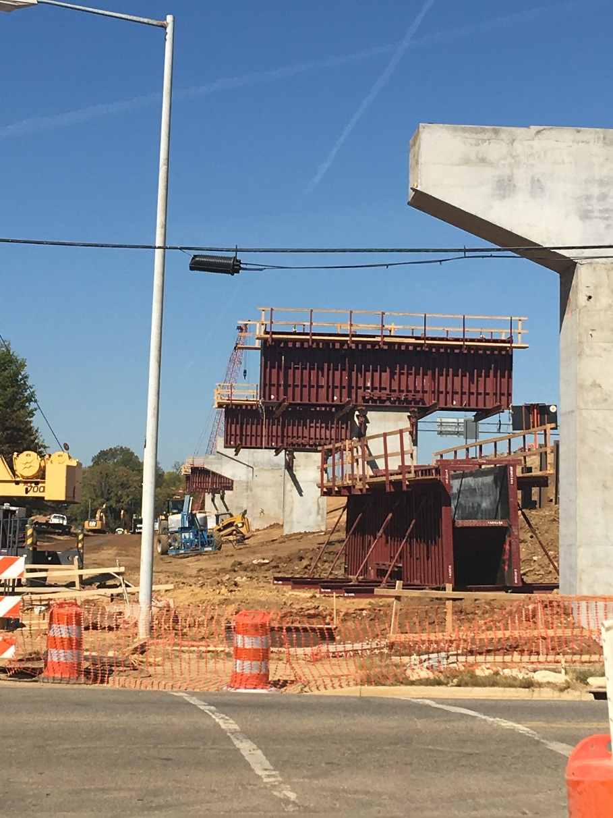
Presentation Objectives
Project overview and description
Micropiles as a design alternative
Design considerations for Micropiles in Karst
Unexpected, Karst-specific challenges
Construction Q/A, Q/C; Specifications
Finishing Thoughts

Slide 3
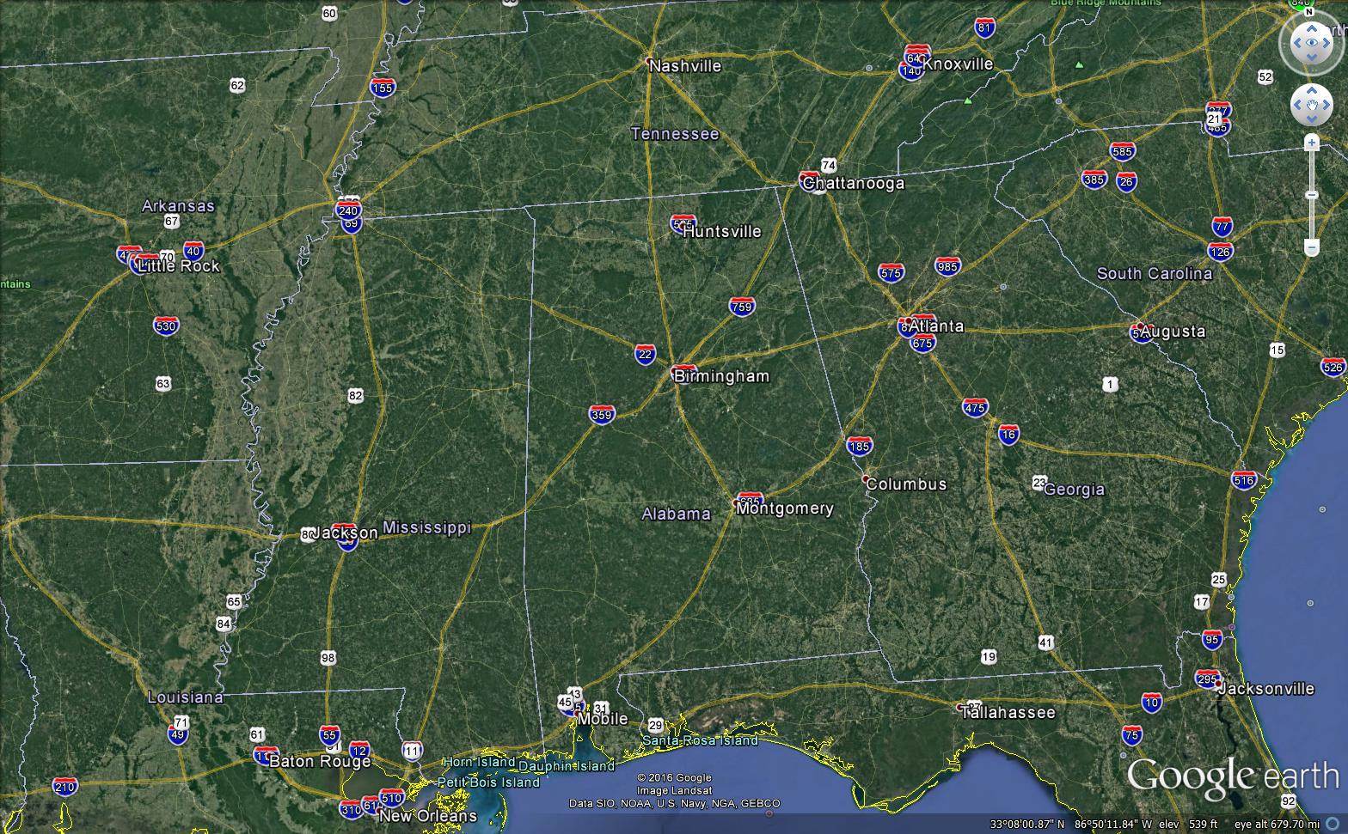
Project Overview
STGEC 2016

Slide 4
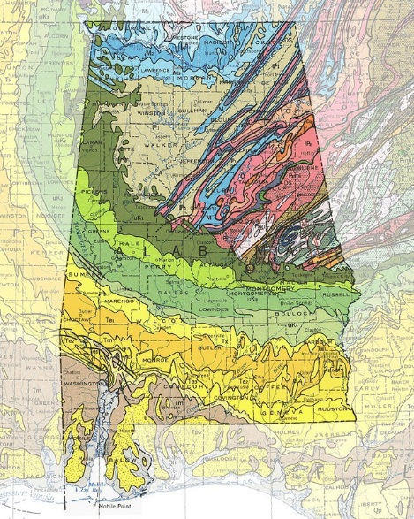
Project Overview

Slide 5

Project Overview

Slide 6
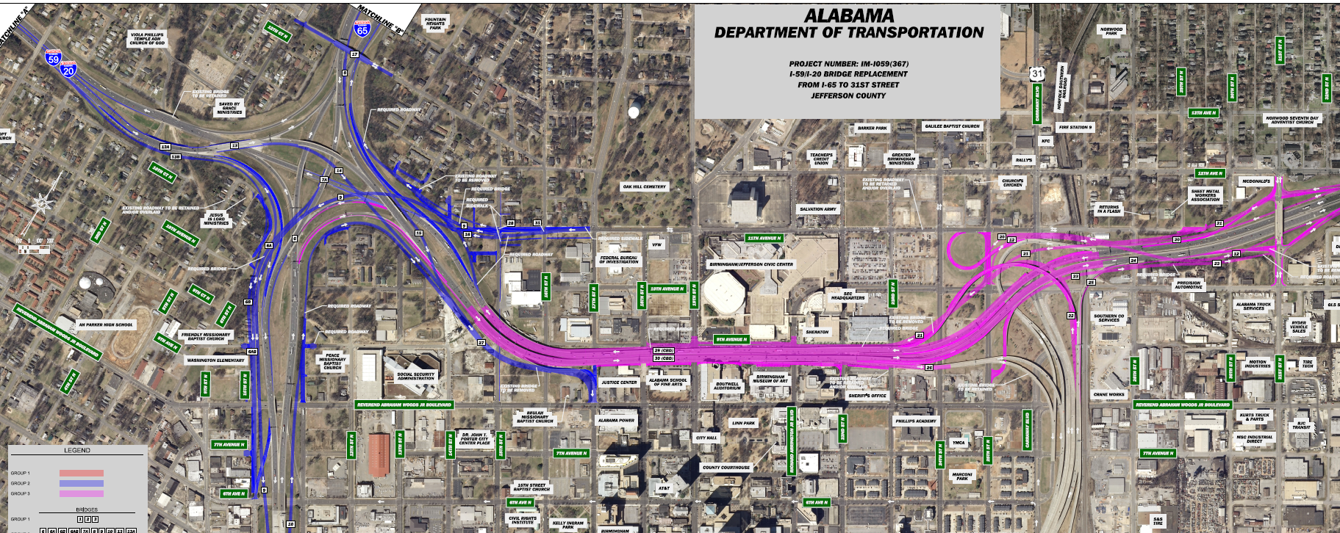
Project Overview
Phase II
Phase III

Slide 7
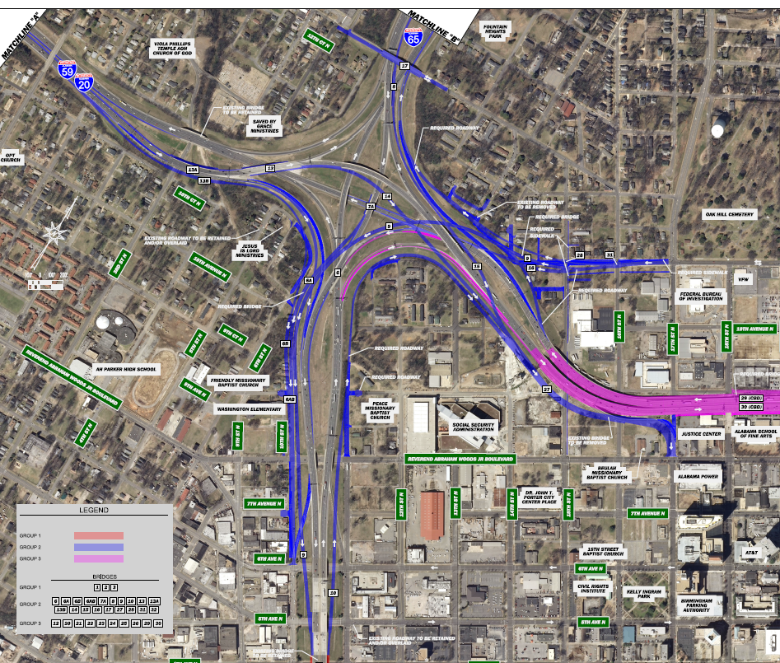
Project Overview

Slide 8
Project Overview
Fun Facts:
Project let January 22, 2016
Low bidder: Granite Construction Co., Watsonville, CA $208,611,848.60
Next lowest bidder: Brasfield & Gorrie, LLC, Birmingham, AL $277,029,808.98
21 Bridges (new or widened)
  19,958.42’ (3.8 miles)
17 Retaining Walls
  146,704 square feet of wall face (3.4 acres)
121,502 LF of Steel H-piles
  23 miles (Pascagoula or Bay St. Louis)
697 LF of Drilled Shafts
40,845 CY of improved foundation soils through Aggregate Foundations
6,625 LF of Pilot Holes

Slide 9
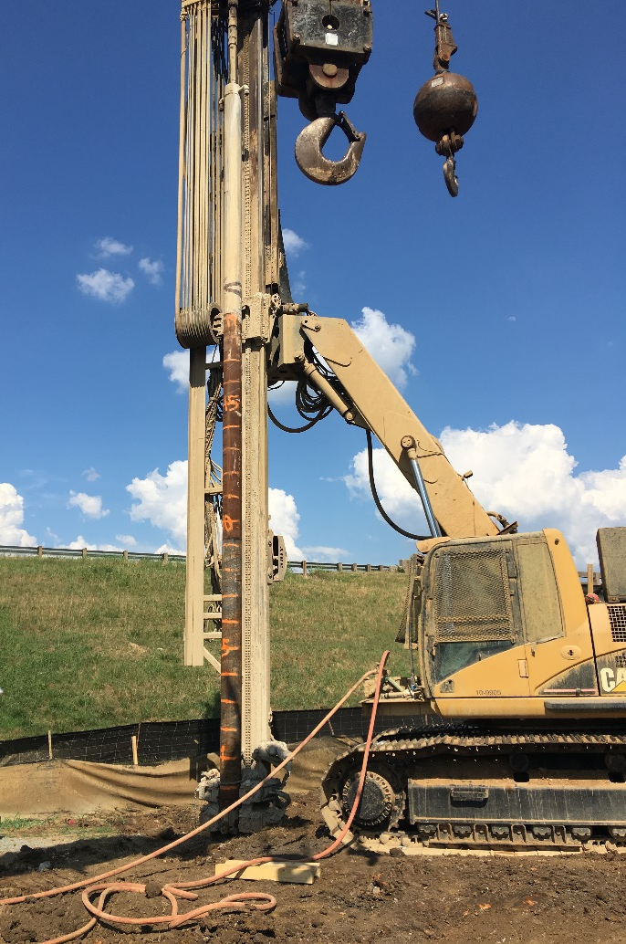
Micropiles as a Design Alternative
6,625 LF of Pilot Holes
Contractor proposed to substitute all pre-drilled H-piles with 9 5/8” micropiles
1 for 1 substitution for H-piles
  No layout changes
45-155 ton design loads
Time Savings
  Micropiles could be installed in roughly ½ the time as the replaced H-piles with pilot holes
  $10,000,000.00 “No-Excuse” Bonus for on-time completion of the project

Slide 10
Micropiles as a Design Alternative
Phase II
Phase III

Slide 11
Micropiles as a Design Alternative

Slide 12
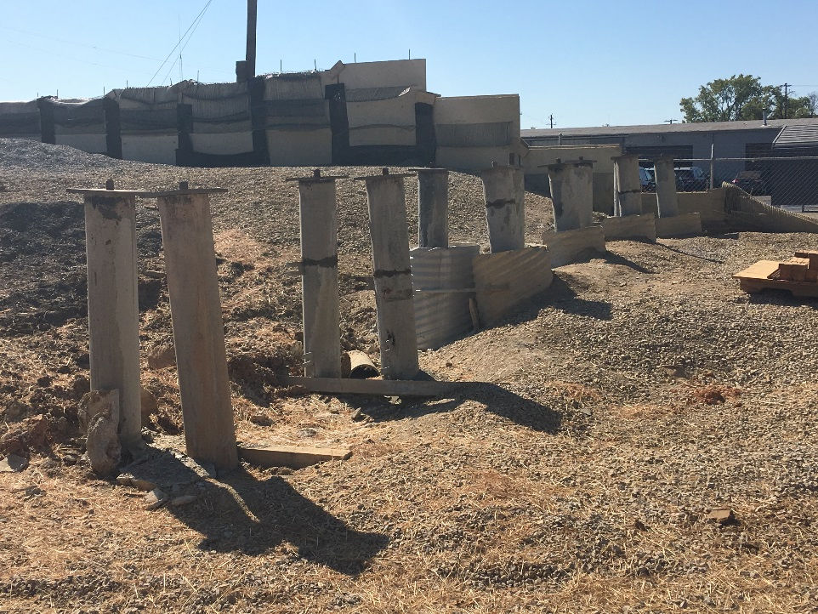
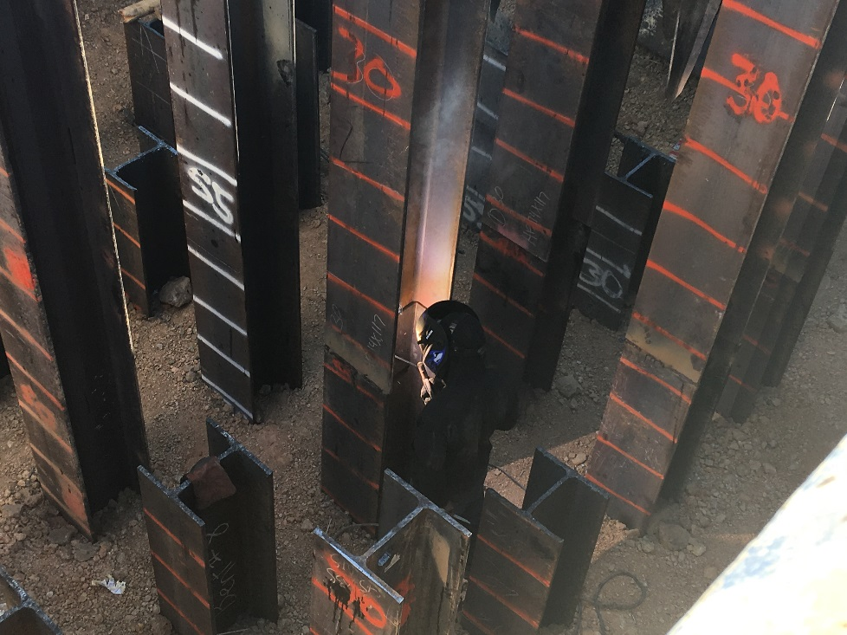
Micropiles as a Design Alternative
Advantages:
Time
Better Foundation?
Gave us another option in case of hiccups elsewhere
Adds a tool to our toolbox
Disadvantages:
(Relatively) inexperienced with Micropiles
Aren’t testing every unit like with H-piles
Differs from what we know works

Slide 13
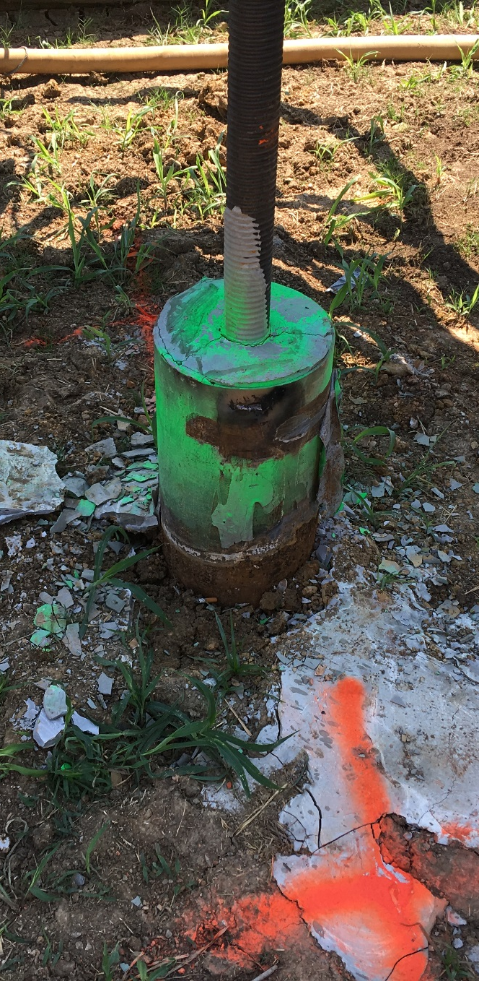
Design Considerations for Micropiles in Karst
Our Concerns:
Need a design that accounts for unknowns
  Voids directly beneath sockets
Need some load tests
  Gain confidence
  Verify Contractor’s design, installation method
  Ensure design validity across project
Need a way for our inspectors to verify Contractor’s claims
  Socket length and quality
Need to know ahead of time what to expect
  Subsurface information
  Karst changes everything

Slide 14
Design Considerations for Micropiles in Karst
Our Stipulations:
Verification Load Test
  200% of the design load, in compression
Proof test 5% of production micropiles
  150% of the design load, in tension
  Minimum 1 proof test per footing
Side resistance only, no base resistance
Capacity cannot be derived from broken/voided/weathered rock
  Capacity must be developed in a continuous, solid rock socket
Must provide a reproducible method of verifying the rock socket
  Cannot be based solely on driller’s observations
Contractor must perform additional investigation at each footing they plan to convert to micropiles
  Need to know ahead of time what to expect

Slide 15
Design Considerations for Micropiles in Karst

Slide 16
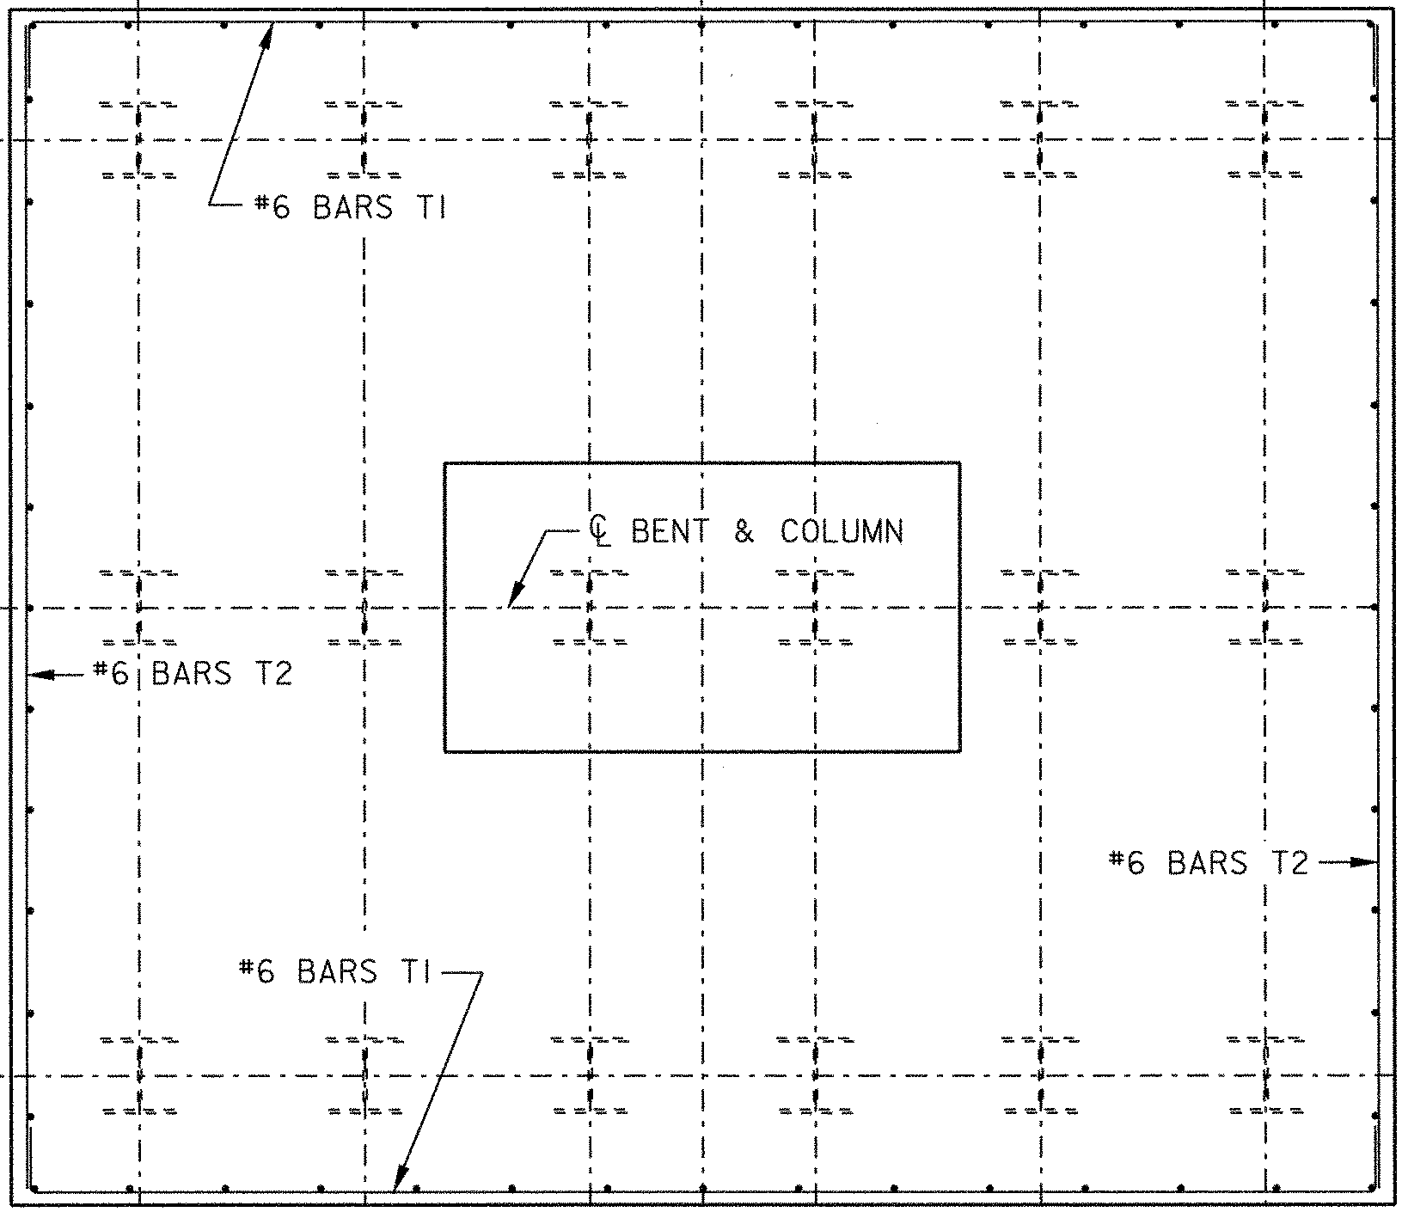
Design Considerations for Micropiles in Karst
“Domino 6” boring pattern

Slide 17
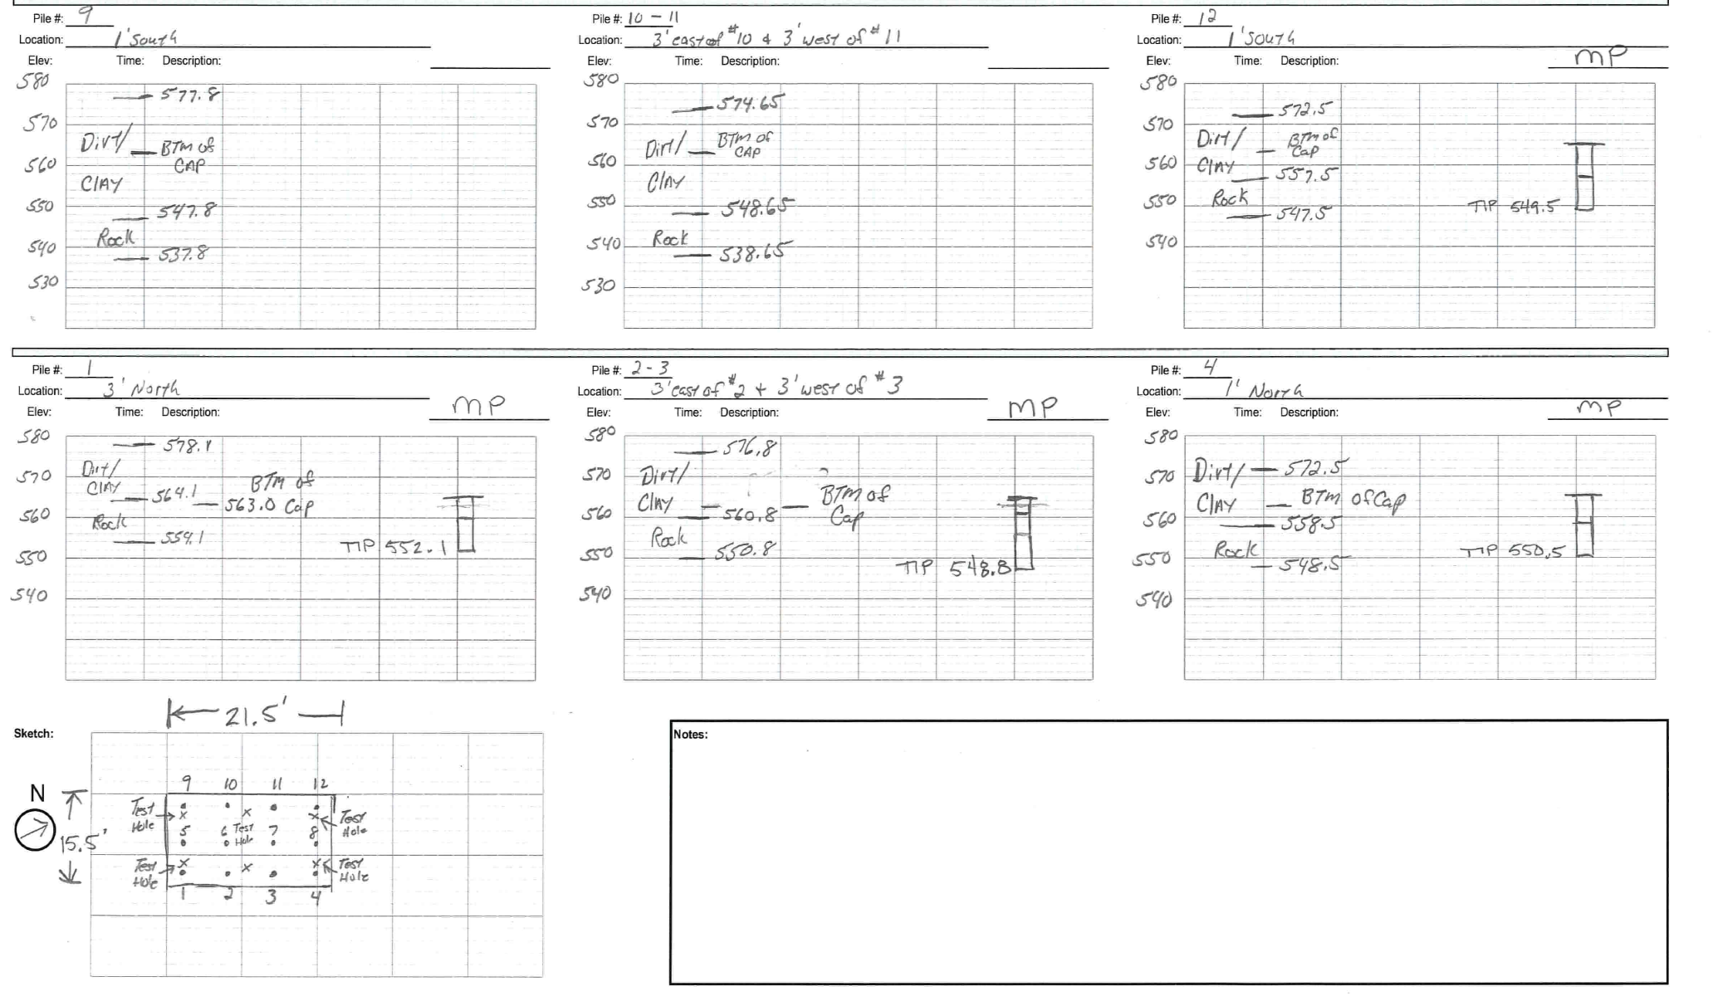
Design Considerations for Micropiles in Karst

Slide 18
Unexpected Challenges

Slide 19
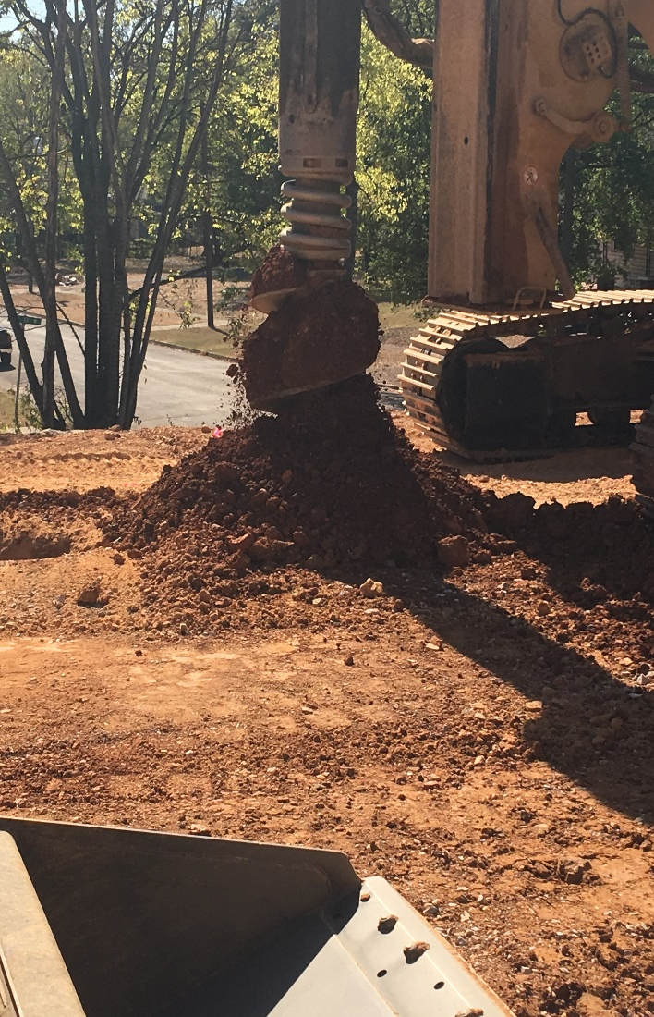
Unexpected Challenges
Cross-Communication between Micropiles
Drill cuttings and/or loose material between joints in the rock formation were traveling from hole to hole during drilling
Rotary Duplex drilling using high-pressure water to flush cuttings
Holes were full of sediment to approximately bottom-of-casing elevations 24-48 hours after drilling was completed
Discovered prior to grouting while rock sockets were being evaluated with a down-hole camera
What are the implications?

Slide 20
Unexpected Challenges
1

Slide 21
Unexpected Challenges
Cross-Communication between Micropiles
Problem #1:
Center reinforcing bar is placed after loose material has settled and bar cannot be advanced the full length of the hole
Remove the bar and go back into hole with the drill to remove loose material
But what did that operation do to the adjacent hole?

Slide 22
Unexpected Challenges
1
2

Slide 23
Unexpected Challenges
Cross-Communication between Micropiles
Problem #2:
Center reinforcing bar is placed before loose material has settled and material settles around the bar and tremie tube
Does the grout push the loose material up and out of the hole?
Does the grout take a preferential, isolated path up and out of the loose material, leaving a contaminated socket?
If you’re monitoring grout takes you would catch the problem, but at that point is it too late?

Slide 24
Unexpected Challenges
1
2
3

Slide 25
Unexpected Challenges
Cross-Communication between Micropiles
Problem #3:
Center reinforcing bar is not required for structural capacity
Significant mixing of grout and loose material, resulting in a contaminated socket
No grout enters the bond zone at all
Again, would likely be caught before grouting, but still causes headaches

Slide 26
Unexpected Challenges
Cross-Communication between Micropiles
Solution:
Determined that holes would have to be all cleaned and then all grouted
  Could not grout a micropile then move over and clean out an adjacent micropile
Contractor was required to perform a weighted tape measurement on two different occasions for each hole
  Immediately after drilling
  Immediately prior to grouting
As long as the two measurements match, the contractor was cleared to grout
If the material is significantly fluid such that the weighted tape could reach the bottom of the hole, then the grout could push it up and out

Slide 27
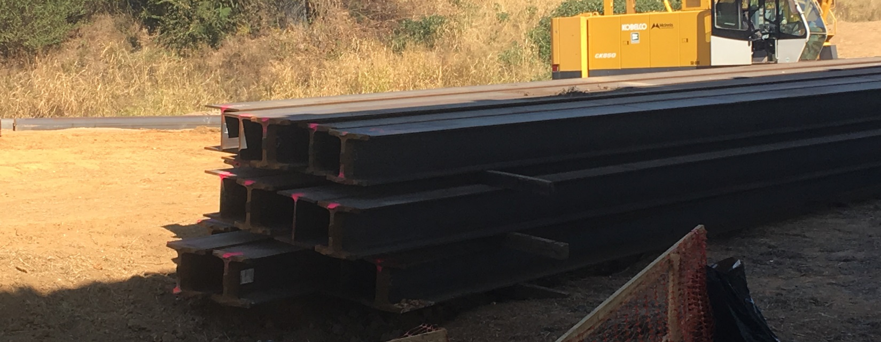
Construction Q/A, Q/C
Specifications
Important things to remember:
Things can change rapidly in Karst
  Assumptions will come back to bite you
  Everything must be verified and re-verified
95% of all micropiles never get tested

Slide 28
Construction Q/A, Q/C
Specifications
Verification Load Test
Recommend this be done in compression
  Contractors won’t like it, but it does a couple of things for us…
  Verifies the design of the micropile under the same loading conditions as it will feel when bridge loads are applied to it
  Requires the installation of 3 total micropiles
    1 test pile, 2 reaction micropiles
    Contractor’s installation methods can be fully evaluated
    Inspectors get more practice

Slide 29
Construction Q/A, Q/C
Specifications
Proof Load Tests
Performed in tension
  Recommend these be performed to a minimum of 150% of the Design Load
    Here’s why…

Slide 30
Construction Q/A, Q/C
Specifications

Slide 31
Construction Q/A, Q/C
Specifications
Proof Load Tests
Performed in tension
  Recommend these be performed to a minimum of 150% of the Design Load
    Here’s why…
  Strain compatibility tells us that the reaction in the short micropile has to be greater than in the long micropile
  If the surface of the rock is sloping severely, all micropiles will not carry the same load
  Must either:
    Have provisions for socket lengths to be adjusted as drilling information is received, or…
    Increase your test load threshold to account for varying lengths in micropiles

Slide 32
Construction Q/A, Q/C
Specifications
“Domino 6” Investigation
One boring per footing will not fully characterize the subsurface in Karst conditions
Contractor and owner mutually agree on “tentative” tip elevations prior to installation
Reduces bias during drilling and installation
  Hopefully eliminates the “oops” and “uh oh’s”
  Gives all parties involved confidence in what they’re doing
Allows Contractor and inspectors to make correlations between drill performance and material type
  Soil, weathered/broken rock, solid rock
  Reduces conflict between driller and inspector
Doesn’t have to be fancy
  Small diameter air-rotary percussion drill
Single most effective provision for reducing tension between owner and contractor

Slide 33
Construction Q/A, Q/C
Specifications
Installation Plan
Pretty standard for drilled foundations
  Karst changes everything
Testing regimen
Reproducible verification of rock socket length/quality
  Independent of driller’s observations
Cross-communication of drilled holes
  Should address sequence of drilling, cleaning, and grouting micropiles
  In Detail
Additional drilling/investigation to fully characterize rock surface
Make the contractor demonstrate everything in their plan during the verification load testing
What is the contractor going to do to ensure the quality of micropiles that are not proof tested?

Slide 34
Construction Q/A, Q/C
Specifications
Other Recommended Provisions
Include provisions that allow you to test micropiles at will
  Separate pay item and unique quantity for proof and verification tests
  Gives you the freedom to test any micropile that you think is suspect
Minimum 1 proof test per footing
  Not simply 5% of production piles
  Things change rapidly in Karst
Make sure your provisions allow for modifications to the design as you move through a project

Slide 35
Final Thoughts
Micropiles can be effective in Karst
Requires attention to detail and a little foresight
Remain calm
Be flexible
Early and often communication with contractor pays significant dividends

Slide 36
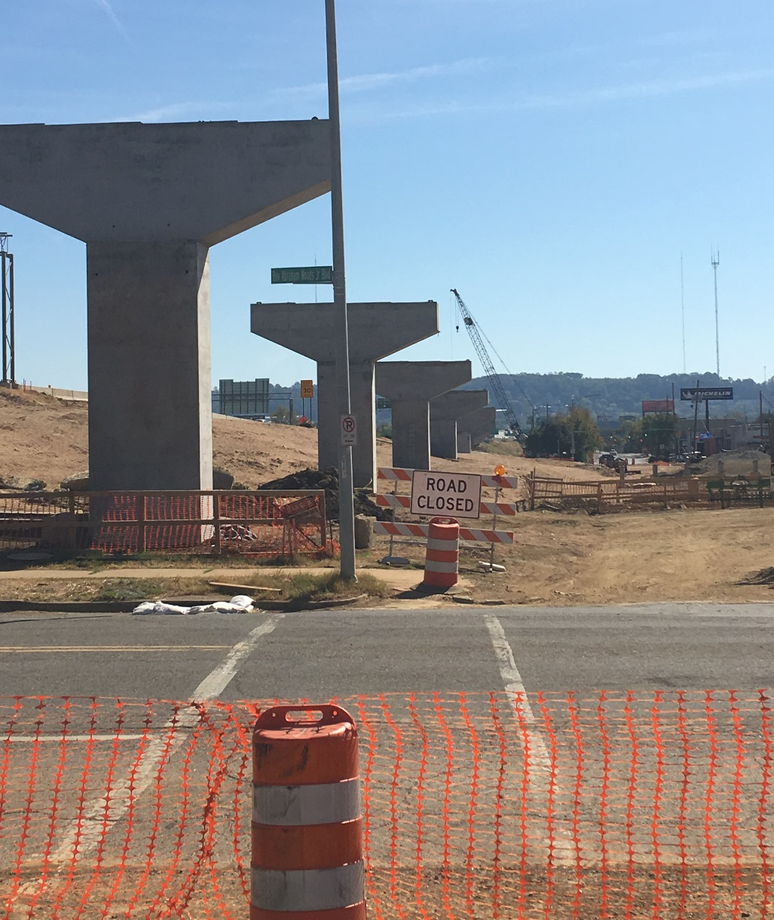
Thank You
Questions?
Stephen M. (Matt) Revell, P.E.
Assistant Geotechnical Engineer, ALDOT
Email: revells@dot.state.al.us
Ph: 334-206-2257

